Slide 1


About the Presentations
The presentations cover the objectives found in the opening of each chapter.
All chapter objectives are listed in the beginning of each presentation.
You may customize the presentations to fit your class needs.
Some figures from the chapters are included. A complete set of images from the book can be found on the Instructor Resources disc.

Slide 2
Database Systems:
Design, Implementation, and Management
Tenth Edition
Chapter 1
Database Systems

Slide 3
Objectives
In this chapter, you will learn:
The difference between data and information
What a database is, the various types of databases, and why they are valuable assets for decision making
The importance of database design
How modern databases evolved from file systems
Database Systems, 10th Edition

Slide 4
Objectives (cont’d.)
About flaws in file system data management
The main components of the database system
The main functions of a database management system (DBMS)
Database Systems, 10th Edition

Slide 5
Introduction
Good decisions require good information derived from raw facts
Data is managed most efficiently when stored in a database
Databases evolved from computer file systems
Understanding file system characteristics is important
Database Systems, 10th Edition

Slide 6
Why Databases?
Databases solve many of the problems encountered in data management
  Used in almost all modern settings involving data management:
    Business
    Research
    Administration
Important to understand how databases work and interact with other applications
Database Systems, 10th Edition

Slide 7
Evolution of File System Data Processing
Reasons for studying file systems:
  Complexity of database design is easier to understand
  Understanding file system problems helps to avoid problems with DBMS systems
  Knowledge of file system is useful for converting file system to database system
File systems typically composed of collection of file folders, each tagged and kept in cabinet
  Organized by expected use
Database Systems, 10th Edition

Slide 8
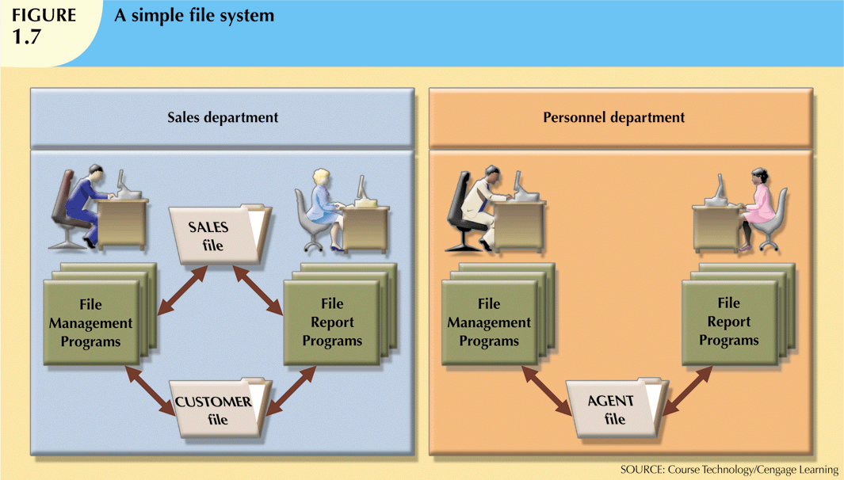
Database Systems, 10th Edition

Slide 9

File Cabinet
Database Systems, 10th Edition

Slide 10
Evolution of File System Data Processing (cont'd.)
Contents of each file folder are logically related
Manual file systems
  Served as a data repository for small data collections
  Cumbersome for large collections
Computerized file systems
  Data processing (DP) specialist converted computer file structure from manual system
    Wrote software that managed the data
    Designed the application programs
Database Systems, 10th Edition

Slide 11
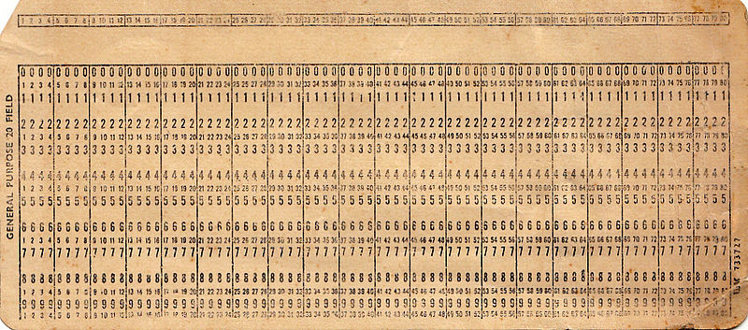
Computer Punch Card
Database Systems, 10th Edition

Slide 12
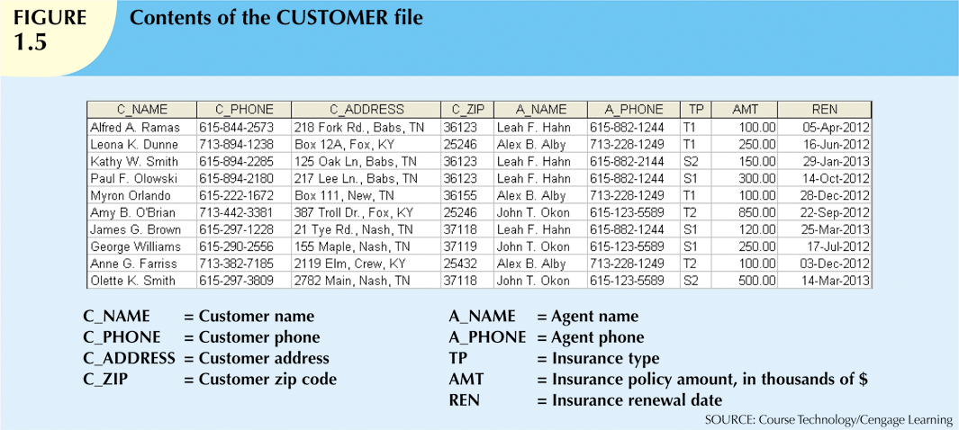
Database Systems, 10th Edition

Slide 13
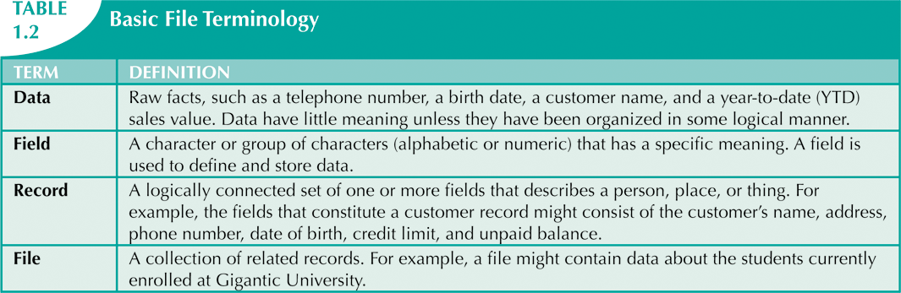
Database Systems, 10th Edition

Slide 14
Evolution of File System Data Processing (cont'd.)
Initially, computer file systems resembled manual systems
As number of files increased, file systems evolved
  Each file used its own application program to store, retrieve, and modify data
  Each file was owned by individual or department that commissioned its creation
Database Systems, 10th Edition

Slide 15
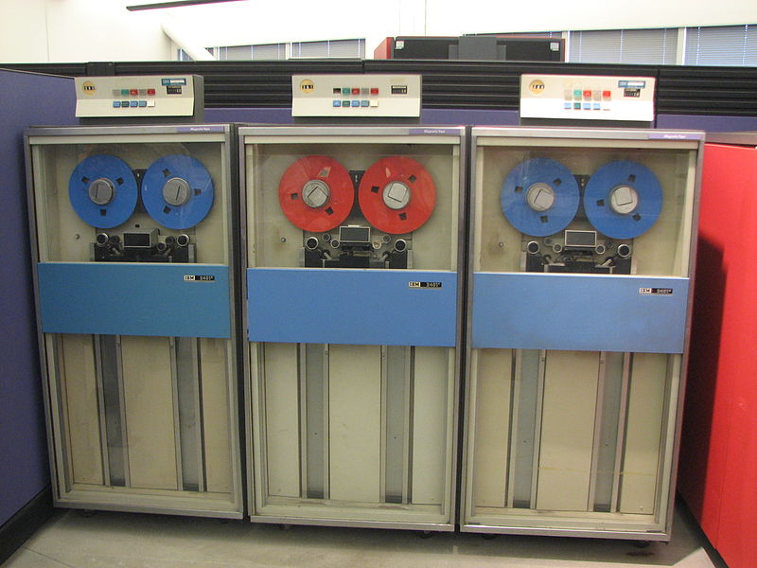
Computer Tape Drives
Database Systems, 10th Edition

Slide 16
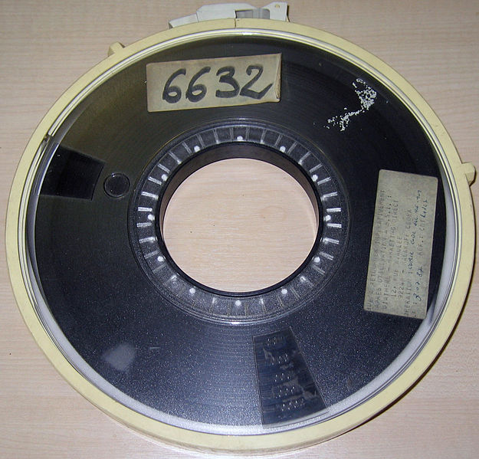
2400’ Magnetic Tape
Database Systems, 10th Edition

Slide 17
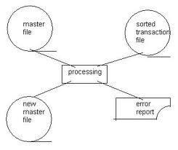
Tape Master File
Database Systems, 10th Edition

Slide 18

200MB Disk 1970
Database Systems, 10th Edition

Slide 19
Disk Advantages
Disk files allow direct access to data on a disk
  Arm moves to the cylinder (~ 1/100th sec)
  Track selected electronic speed
  Starting point comes around (Avg 1/500th sec)
Multiple Users can access the disk at the same time.
Data changed in place
Database Systems, 10th Edition

Slide 20
Disk Disadvantages
Only one copy of the data. If data is changed you can’t just rewind to get back to the start of the program.
Multiple user access can create data anomalies if two people are trying to save the same record
Example, two people trying to purchase the last seat on an airplane.
Database Systems, 10th Edition

Slide 21
Introducing the Database
Database: shared, integrated computer structure that stores a collection of:
  End-user data: raw facts of interest to end user
  Metadata: data about data
    Provides description of data characteristics and relationships in data
    Complements and expands value of data
Database management system (DBMS): collection of programs
  Manages structure and controls access to data
Database Systems, 10th Edition

Slide 22
Role and Advantages of the DBMS
DBMS is the intermediary between the user and the database
  Database structure stored as file collection
  Can only access files through the DBMS
DBMS enables data to be shared
DBMS integrates many users’ views of the data
Database Systems, 10th Edition

Slide 23
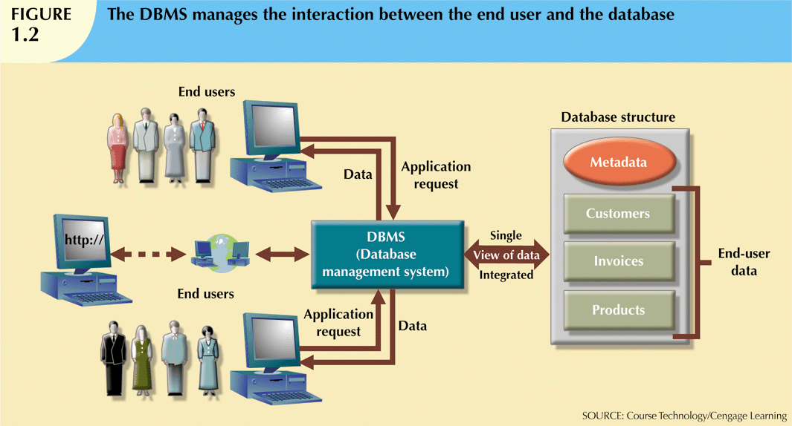
Database Systems, 10th Edition

Slide 24
Data vs. Information
Data are raw facts
Information is the result of processing raw data to reveal meaning
Information requires context to reveal meaning
Raw data must be formatted for storage, processing, and presentation
Data are the foundation of information, which is the bedrock of knowledge
Database Systems, 10th Edition

Slide 25
Data vs. Information (cont’d.)
Data: building blocks of information
Information produced by processing data
Information used to reveal meaning in data
Accurate, relevant, timely information is the key to good decision making
Good decision making is the key to organizational survival
Data management: focuses on proper generation, storage, and retrieval of data
Database Systems, 10th Edition

Slide 26
Why Database Design Is Important
Database design focuses on design of database structure used for end-user data
  Designer must identify database’s expected use
Well-designed database:
  Facilitates data management
  Generates accurate and valuable information
Poorly designed database:
  Causes difficult-to-trace errors
Database Systems, 10th Edition

Slide 27
Database Systems, 10th Edition

Slide 28
Role and Advantages of the DBMS (cont’d.)
Advantages of a DBMS:
  Improved data sharing
  Improved data security
  Better data integration
  Minimized data inconsistency
  Improved data access
  Improved decision making
  Increased end-user productivity
Database Systems, 10th Edition

Slide 29
Types of Databases
Databases can be classified according to:
  Number of users
  Database location(s)
  Expected type and extent of use
Single-user database supports only one user at a time
  Desktop database: single-user; runs on PC
Multiuser database supports multiple users at the same time
  Workgroup and enterprise databases
Database Systems, 10th Edition

Slide 30
Types of Databases (cont’d.)
Centralized database: data located at a single site
Distributed database: data distributed across several different sites
Operational database: supports a company’s day-to-day operations
  Transactional or production database
Data warehouse: stores data used for tactical or strategic decisions
Database Systems, 10th Edition

Slide 31
Types of Databases (cont'd.)
Unstructured data exist in their original state
Structured data result from formatting
  Structure applied based on type of processing to be performed
Semistructured data have been processed to some extent
Extensible Markup Language (XML) represents data elements in textual format
  XML database supports semistructured XML data
Database Systems, 10th Edition

Slide 32
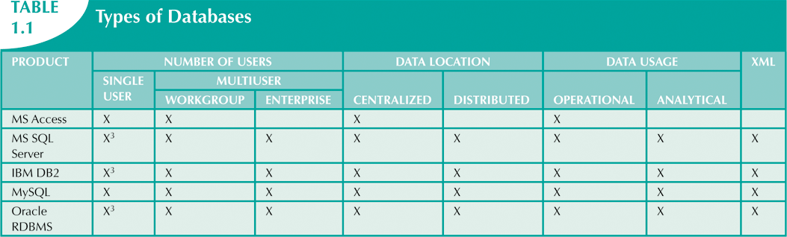
Database Systems, 10th Edition

Slide 33
File System Redux: Modern End-User Productivity Tools
Ubiquitous use of personal productivity tools can introduce the same problems as the old file systems
Microsoft Excel
  Widely used by business users
  Users have become so adept at working with spreadsheets, they tend to use them to complete tasks for which spreadsheets are not appropriate – database substitute
Database Systems, 10th Edition

Slide 34
Problems with File System Data Processing
File systems were an improvement over manual system
  File systems used for more than two decades
  Understanding the shortcomings of file systems aids in development of modern databases
  Many problems not unique to file systems
Even simple file system retrieval task required extensive programming
  Ad hoc queries impossible
  Changing existing structure difficult
Database Systems, 10th Edition

Slide 35
Problems with File System Data Processing (cont'd.)
Security features difficult to program
  Often omitted in file system environments
Summary of file system limitations:
  Requires extensive programming
  Cannot perform ad hoc queries
  System administration is complex and difficult
  Difficult to make changes to existing structures
  Security features are likely to be inadequate
Database Systems, 10th Edition

Slide 36
Structural and Data Dependence
Structural dependence: access to a file is dependent on its own structure
  All file system programs must be modified to conform to a new file structure
Structural independence: change file structure without affecting data access
Data dependence: data access changes when data storage characteristics change
Data independence: data storage characteristics do not affect data access
Database Systems, 10th Edition

Slide 37
Structural and Data Dependence (cont'd.)
Practical significance of data dependence is difference between logical and physical format
Logical data format: how human views the data
Physical data format: how computer must work with data
Each program must contain:
  Lines specifying opening of specific file type
  Record specification
  Field definitions
Database Systems, 10th Edition

Slide 38
Data Redundancy
File system structure makes it difficult to combine data from multiple sources
  Vulnerable to security breaches
Organizational structure promotes storage of same data in different locations
  Islands of information
Data stored in different locations is unlikely to be updated consistently
Data redundancy: same data stored unnecessarily in different places
Database Systems, 10th Edition

Slide 39
Database Systems, 10th Edition

Slide 40
Data Redundancy (cont'd.)
Data inconsistency: different and conflicting versions of same data occur at different places
Data anomalies: abnormalities when all changes in redundant data are not made correctly
  Update anomalies
  Insertion anomalies
  Deletion anomalies
Database Systems, 10th Edition

Slide 41
Lack of Design and Data-Modeling Skills
Most users lack the skill to properly design databases
  Despite multiple personal productivity tools being available
Data-modeling skills
  Vital in the data design process
Good data modeling facilitates communication between the designer, user, and the developer
Database Systems, 10th Edition

Slide 42
Database Systems
Database system consists of logically related data stored in a single logical data repository
  May be physically distributed among multiple storage facilities
  DBMS eliminates most of file system’s problems
  Current generation stores data structures, relationships between structures, and access paths
    Also defines, stores, and manages all access paths and components
Database Systems, 10th Edition

Slide 43
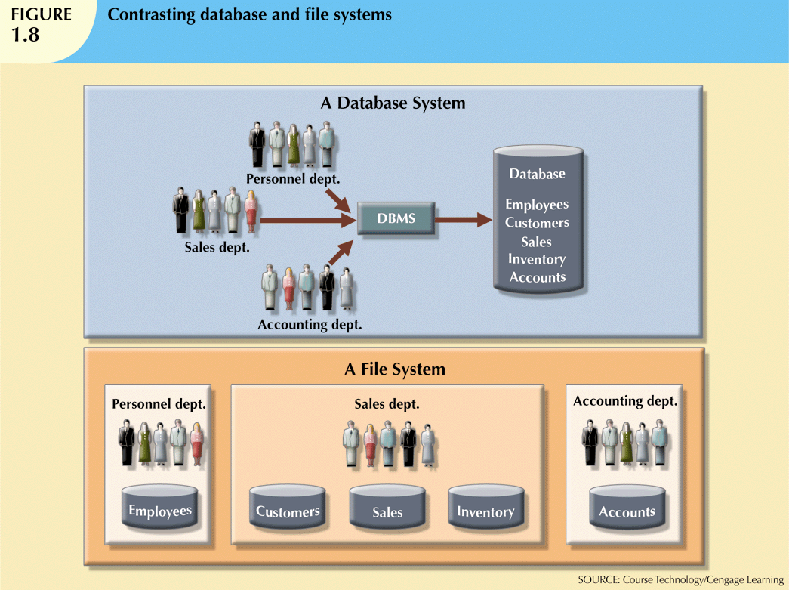
Database Systems, 10th Edition

Slide 44
The Database System Environment
Database system: defines and regulates the collection, storage, management, use of data
Five major parts of a database system:
  Hardware
  Software
  People
  Procedures
  Data
Database Systems, 10th Edition

Slide 45
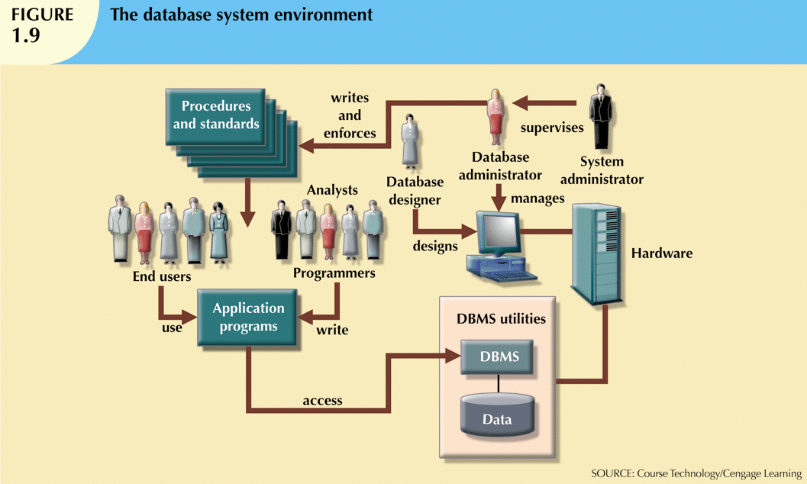
Database Systems, 10th Edition

Slide 46
The Database System Environment (cont'd.)
Hardware: all the system’s physical devices
Software: three types of software required
  Operating system software
  DBMS software
  Application programs and utility software
Database Systems, 10th Edition

Slide 47
The Database System Environment (cont'd.)
People: all users of the database system
  System and database administrators
  Database designers
  Systems analysts and programmers
  End users
Procedures: instructions and rules that govern the design and use of the database system
Data: the collection of facts stored in the database
Database Systems, 10th Edition

Slide 48
The Database System Environment (cont'd.)
Database systems are created and managed at different levels of complexity
Database solutions must be cost-effective as well as tactically and strategically effective
Database technology already in use affects selection of a database system
Database Systems, 10th Edition

Slide 49
DBMS Functions
Most functions are transparent to end users
  Can only be achieved through the DBMS
Data dictionary management
  DBMS stores definitions of data elements and relationships (metadata) in a data dictionary
  DBMS looks up required data component structures and relationships
  Changes automatically recorded in the dictionary
  DBMS provides data abstraction and removes structural and data dependency
Database Systems, 10th Edition

Slide 50
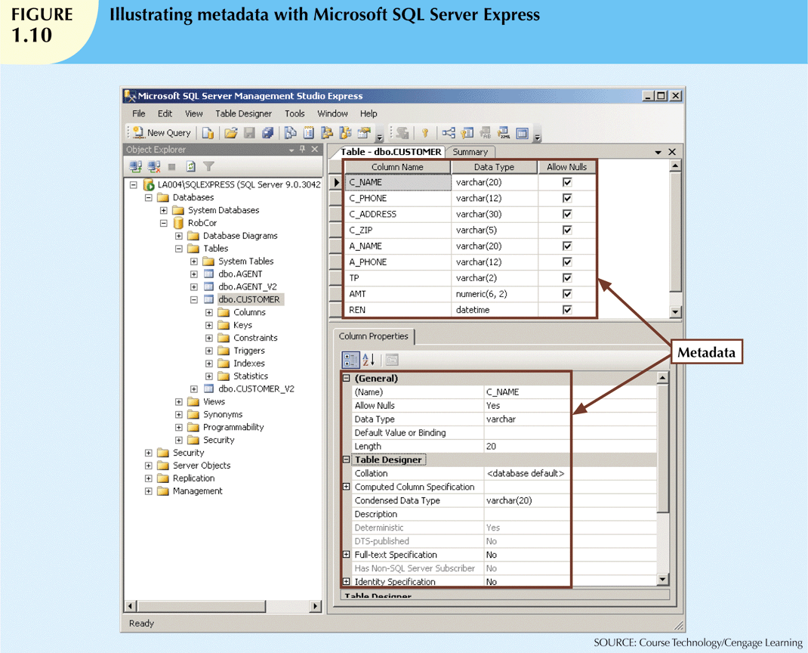
Database Systems, 10th Edition

Slide 51
DBMS Functions (cont'd.)
Data storage management
  DBMS creates and manages complex structures required for data storage
  Also stores related data entry forms, screen definitions, report definitions, etc.
  Performance tuning: activities that make the database perform more efficiently
  DBMS stores the database in multiple physical data files
Database Systems, 10th Edition

Slide 52
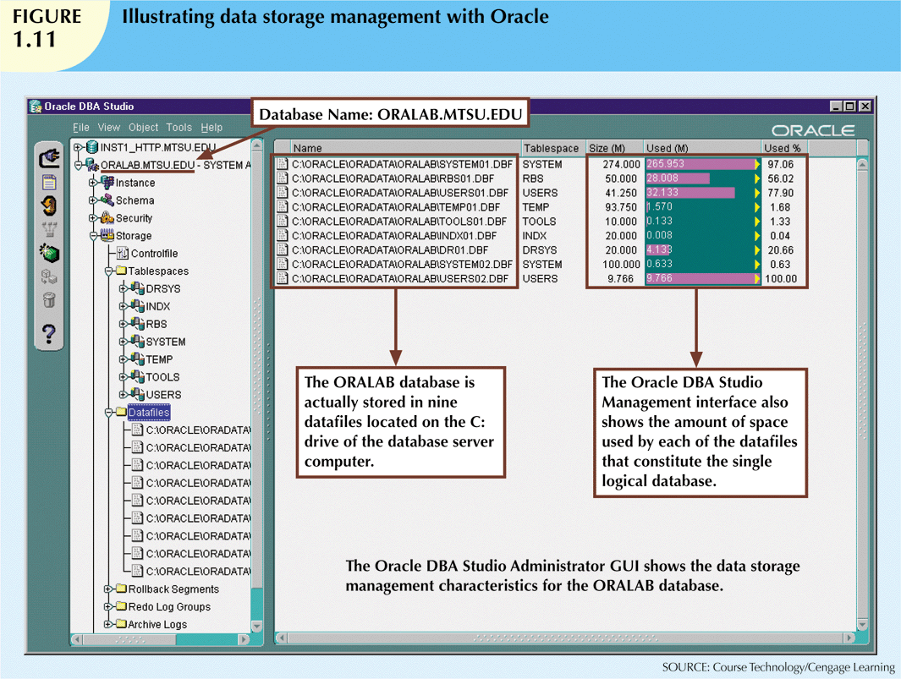
Database Systems, 10th Edition

Slide 53
DBMS Functions (cont'd.)
Data transformation and presentation
  DBMS transforms data entered to conform to required data structures
  DBMS transforms physically retrieved data to conform to user’s logical expectations
Security management
  DBMS creates a security system that enforces user security and data privacy
  Security rules determine which users can access the database, which items can be accessed, etc.
Database Systems, 10th Edition

Slide 54
DBMS Functions (cont'd.)
Multiuser access control
  DBMS uses sophisticated algorithms to ensure concurrent access does not affect integrity
Backup and recovery management
  DBMS provides backup and data recovery to ensure data safety and integrity
  Recovery management deals with recovery of database after a failure
    Critical to preserving database’s integrity
Database Systems, 10th Edition

Slide 55
DBMS Functions (cont'd.)
Data integrity management
  DBMS promotes and enforces integrity rules
    Minimizes redundancy
    Maximizes consistency
  Data relationships stored in data dictionary used to enforce data integrity
  Integrity is especially important in transaction-oriented database systems
Database Systems, 10th Edition

Slide 56
DBMS Functions (cont'd.)
Database access languages and application programming interfaces
  DBMS provides access through a query language
  Query language is a nonprocedural language
  Structured Query Language (SQL) is the de facto query language
    Standard supported by majority of DBMS vendors
    Eg. Select * From Employee;
Database Systems, 10th Edition

Slide 57
DBMS Functions (cont'd.)
Database communication interfaces
  Current DBMSs accept end-user requests via multiple different network environments
  Communications accomplished in several ways:
    End users generate answers to queries by filling in screen forms through Web browser
    DBMS automatically publishes predefined reports on a Web site
    DBMS connects to third-party systems to distribute information via e-mail
Database Systems, 10th Edition

Slide 58
Managing the Database System:
A Shift in Focus
Database system provides a framework in which strict procedures and standards enforced
  Role of human changes from programming to managing organization’s resources
Database system enables more sophisticated use of the data
Data structures created within the database and their relationships determine effectiveness
Database Systems, 10th Edition

Slide 59
Managing the Database System:
A Shift in Focus (cont'd.)
Disadvantages of database systems:
  Increased costs
  Management complexity
  Maintaining currency
  Vendor dependence
  Frequent upgrade/replacement cycles
Database Systems, 10th Edition

Slide 60
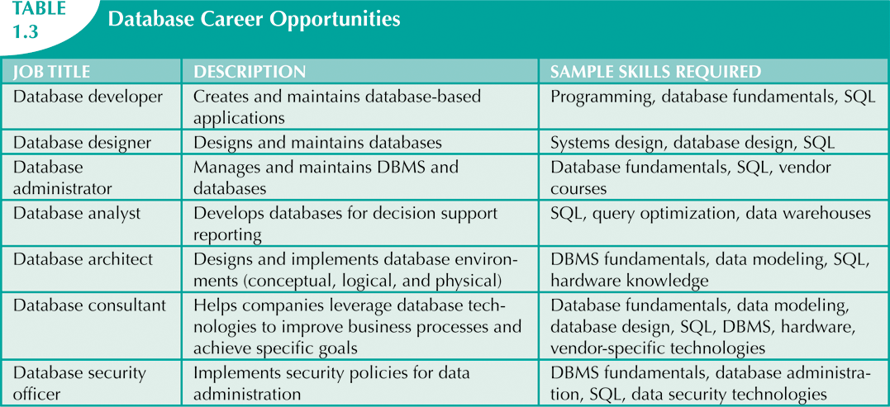
Preparing for Your Database Professional Career
Database Systems, 10th Edition

Slide 61
Source
Slides from Course Text book Coronel, Morris and Rob
Some pictures taken from Wikipedia
Database Systems, 10th Edition

Slide 62
Summary
Data are raw facts
Information is the result of processing data to reveal its meaning
Accurate, relevant, and timely information is the key to good decision making
Data are usually stored in a database
DBMS implements a database and manages its contents
Database Systems, 10th Edition

Slide 63
Summary (cont'd.)
Metadata is data about data
Database design defines the database structure
  Well-designed database facilitates data management and generates valuable information
  Poorly designed database leads to bad decision making and organizational failure
Databases evolved from manual and computerized file systems
Database Systems, 10th Edition

Slide 64
Summary (cont'd.)
In a file system, data stored in independent files
  Each requires its own management program
Some limitations of file system data management:
  Requires extensive programming
  System administration is complex and difficult
  Changing existing structures is difficult
  Security features are likely inadequate
  Independent files tend to contain redundant data
    Structural and data dependency problems
Database Systems, 10th Edition

Slide 65
Summary (cont'd.)
Database management systems were developed to address file system’s inherent weaknesses
DBMS present database to end user as single repository
  Promotes data sharing
  Eliminates islands of information
DBMS enforces data integrity, eliminates redundancy, and promotes security
Database Systems, 10th Edition

